Slide 1
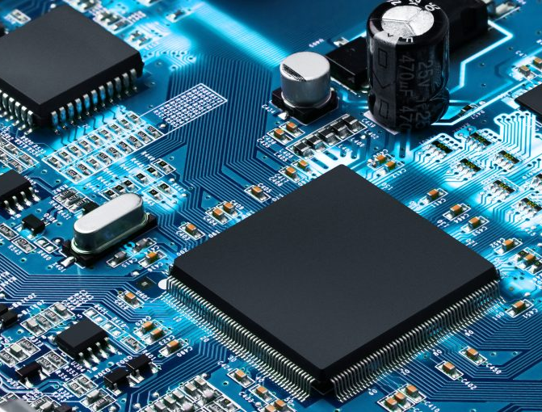



PEMROSESAN PARALEL
CCE60218

Slide 2
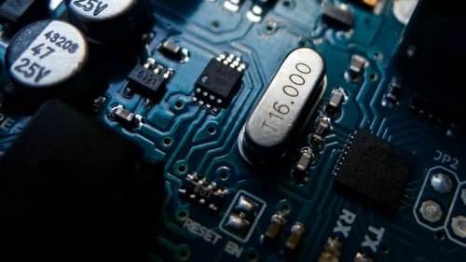
Introduction to Parallelism

Slide 3
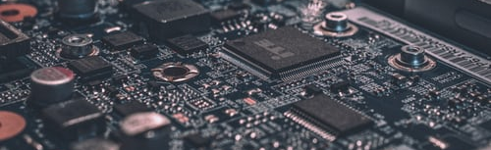
What is parallel processing?
Serial Processing
A processing in which one task is completed at a time and all the tasks are run by the processor in a sequence. In real time example, people standing in a queue and waiting for a railway ticket.
Parallel Processing
A type of processing in which multiple tasks are completed at a time by different processors. In real time example, there are multiple queues of people standing to get railway tickets.

Slide 4
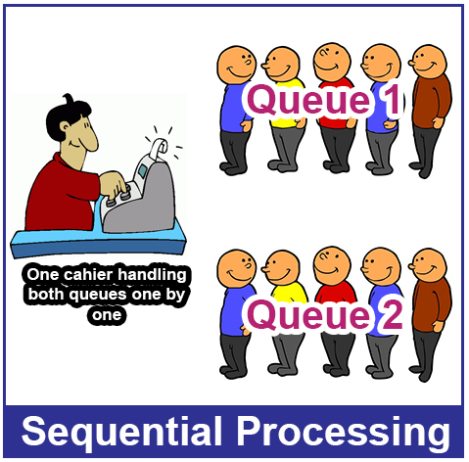
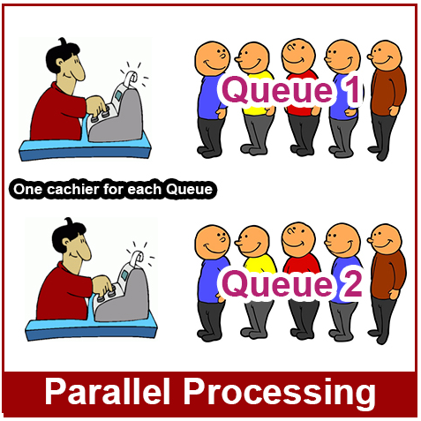
Serial & Parallel

Slide 5
Parallel processing motivation
The role of parallelism in accelerating computing speeds has been recognized for several decades.
Its role in providing multiplicity of data paths and increased access to storage elements has been significant in commercial applications
The scalable performance and lower cost of parallel platforms is reflected in the wide variety of application.

Slide 6
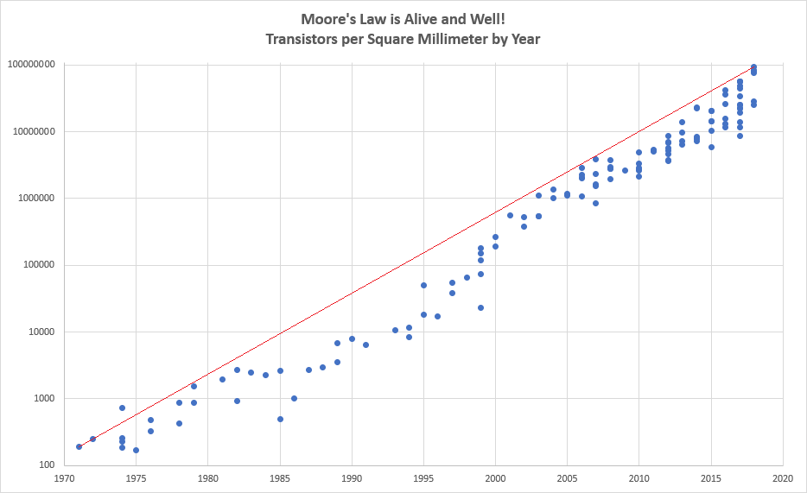
The computational power argument

Slide 7
The computational power argument
If one is to buy into Moore’s law, the question remains – how does one translate transistors into useful OPS (operations per second)?
The logical recourse is to rely on parallelism, both implicit and explicit.
Most serial (or seemingly serial) processors rely extensively on implicit parallelism.
We focus on this class, for the most part, on explicit parallelism.

Slide 8
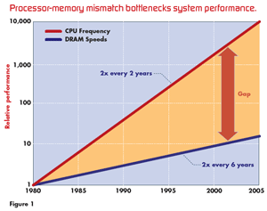
The memory/disk speed argument
While clock rates of high-end processors have increased at roughly 40% per year over the past decade, DRAM access times have only improved at the rate of roughly 10% per year over this interval.
This mismatch in speeds causes significant performance bottlenecks.
Parallel platforms provide increased bandwidth to the memory system.

Slide 9
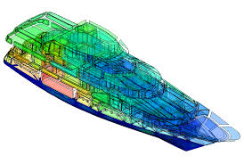
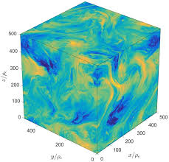

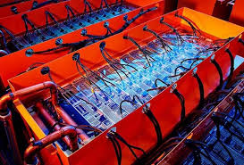
Scope of Parallel Computing Application
Parallelism finds applications in very diverse application domains for different motivating reasons.
These range from improved application performance to cost considerations
Enginering
Scientific
Commercial
Computer System

Slide 10

Terima Kasih

